Slide 1

Chicago Crime Analysis and Predictive Modeling
By: Group 39
Tanmay Pramanick – A20541164
Kunal Rajput – A20540912
Dhruv Patel – A20545903
Soham Sonar – A20541266

Slide 2
Project Overview
Objective -
Analyze Chicago crime data to uncover patterns.
Predict crime types based on features using ML.
Dataset -
Accessed via Socrata API, featuring 100,000 Chicago crime records from a 1.9+ GiB dataset at Chicago Data Portal.
Approach -
Explore. Analyze. Predict.

Slide 3
Workflow
Data Collection and Cleaning
Exploratory Data Analysis
Dimensionality Reduction (PCA, UMAP, t-SNE)
Clustering and Unsupervised Learning
Cross-Validation and Baseline Models
Model Tuning and Experiments
Insights and Predictions
Data Collection and Cleaning
Exploratory Data Analysis
Dimensionality Reduction (PCA, UMAP, t-SNE)
Clustering and Unsupervised Learning
Cross-Validation and Baseline Models
Model Tuning and Experiments
Insights and Predictions

Slide 4
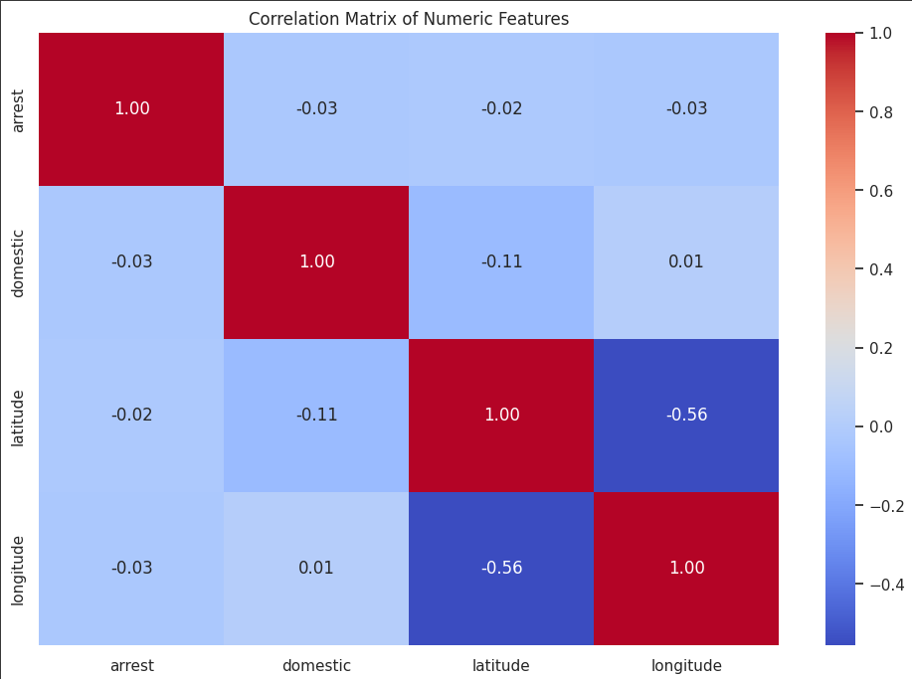
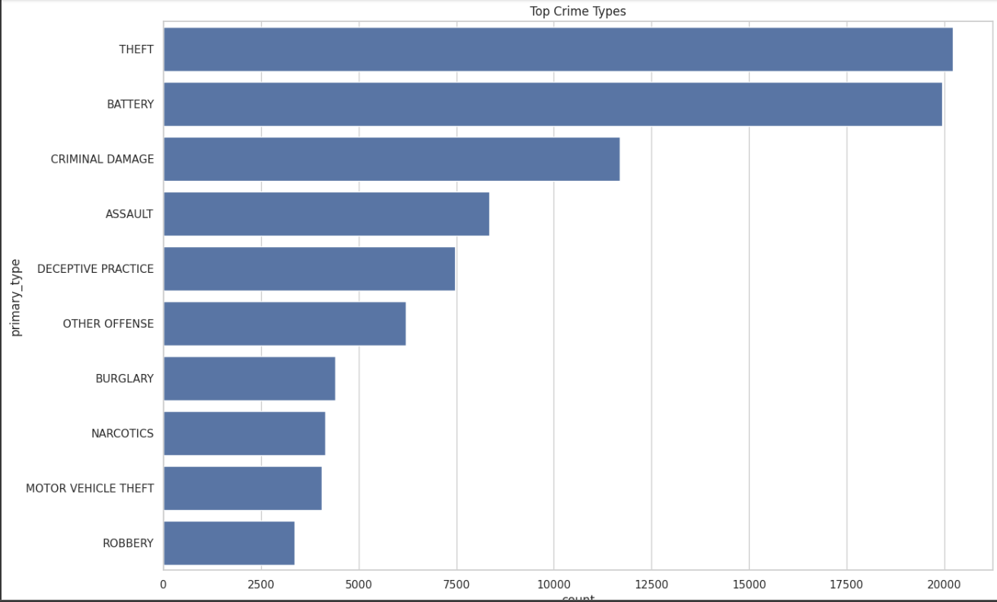
Exploratory Data Analysis
Correlation heatmaps to identify feature relationships.
Bar Chart: Highlighting the top 10 most frequent crime types

Slide 5
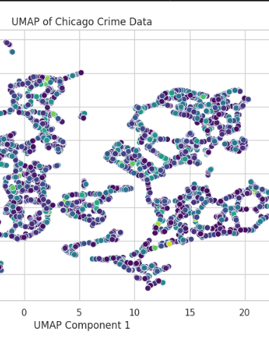
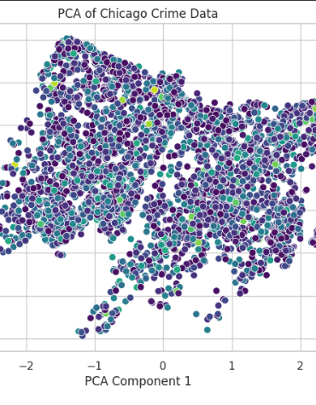
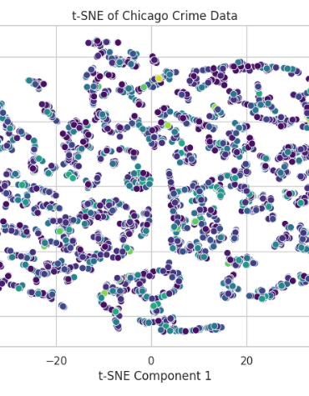
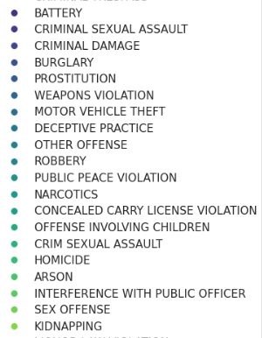
Dimensionality Reduction
Techniques used: PCA, UMAP, t-SNE.
Objective: To visualize high-dimensional data in 2D.
Key insights: Crime types cluster naturally in reduced dimensions.
UMAP provided the most interpretable clustering.

Slide 6
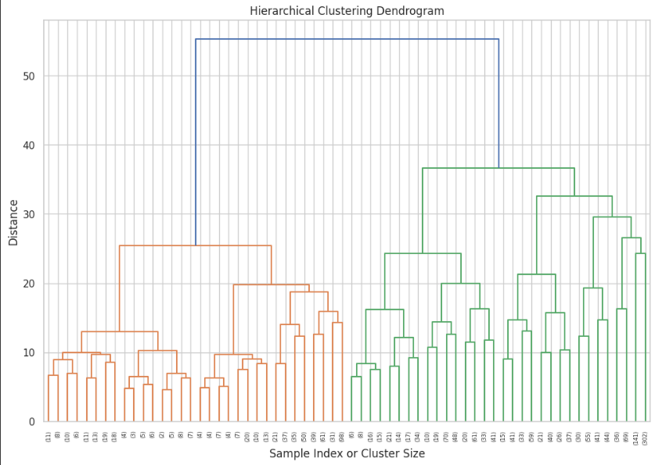
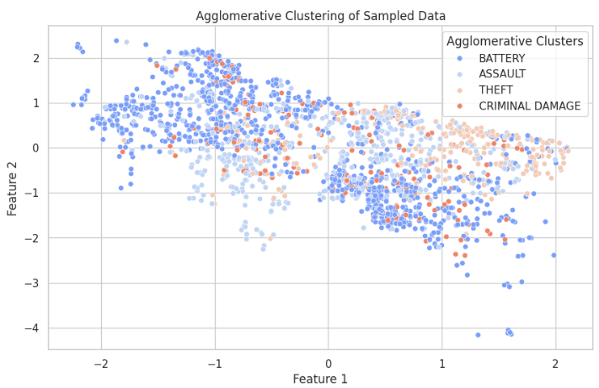
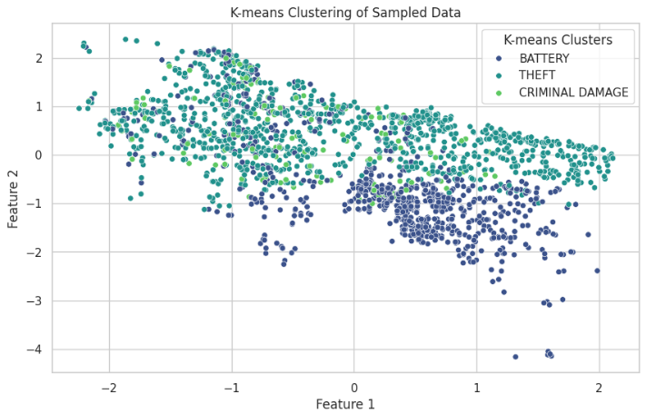
Clustering / Unsupervised Learning
Techniques: K-means, Agglomerative and Hierarchical Clustering.
Objective: Group similar crime types.
Key Findings: Natural groupings of related crimes, e.g., violent crimes and property crimes.

Slide 7
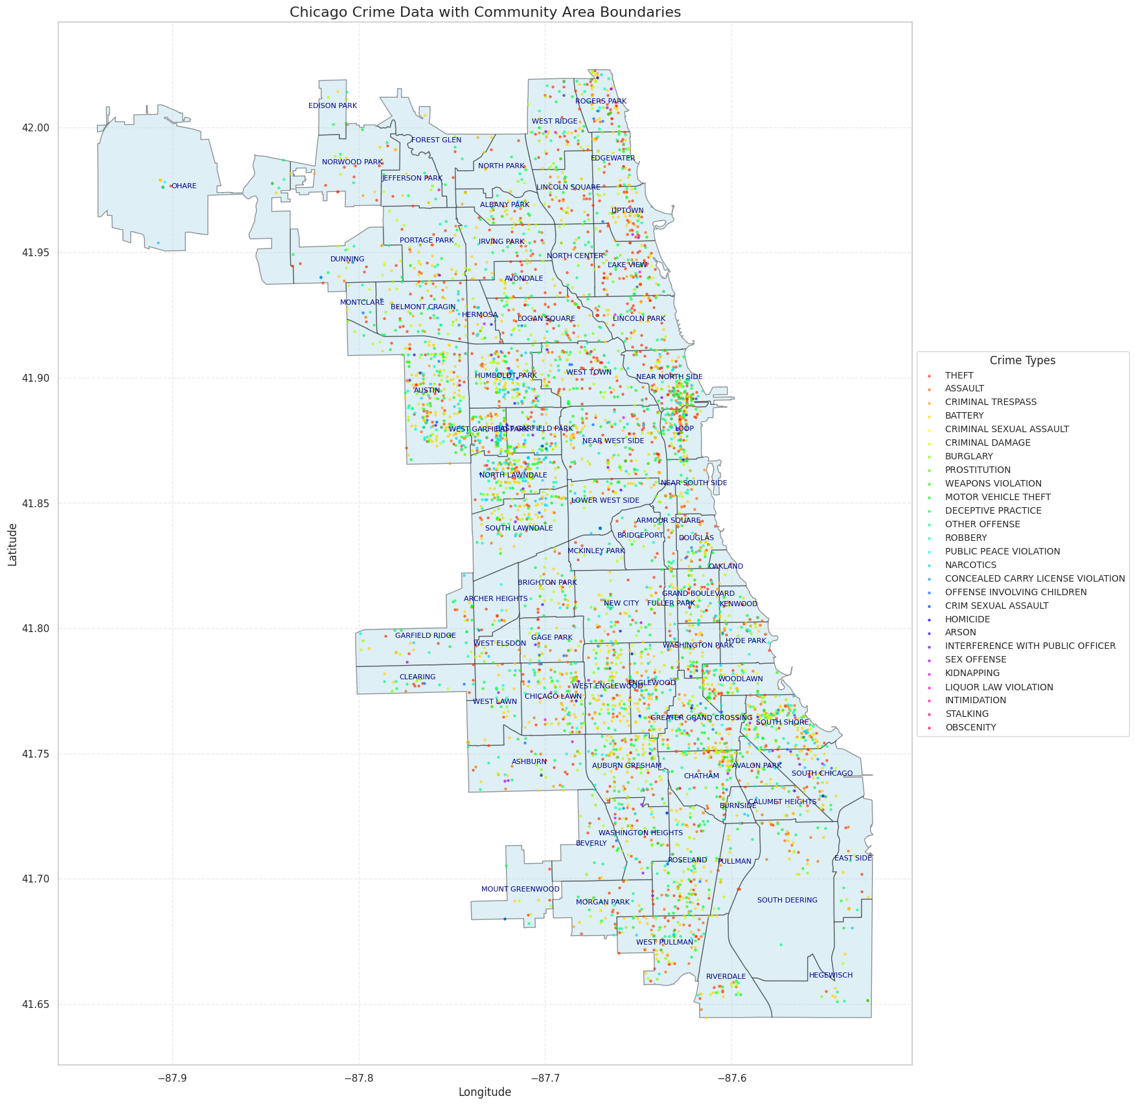
Geospatial Visualization
Data: 5,000 crime records and Chicago community boundaries from the Chicago Data Portal.
Methodology: Plotted crimes on a Chicago map using Geopandas, color-coded by crime type, with labeled community areas.
Insights: Identified crime hotspots and patterns across 77 neighborhoods, highlighting central areas as key crime zones.

Slide 8
Data Preparation and Model Training
Data Preparation: Filtered rare crime classes and preprocessed 4,999 samples with 20,003 features using scaling (numeric) and encoding (categorical).
Cross-Validation: Adopted StratifiedKFold to ensure balanced crime type distribution across training/validation splits.
Baseline Model: Trained a Random Forest classifier with a cross-validation accuracy of 99%, establishing a strong starting point for predictions.

Slide 9
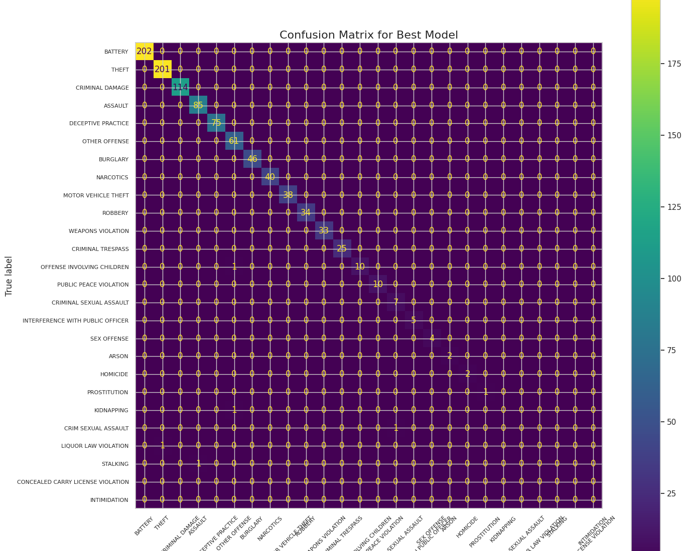
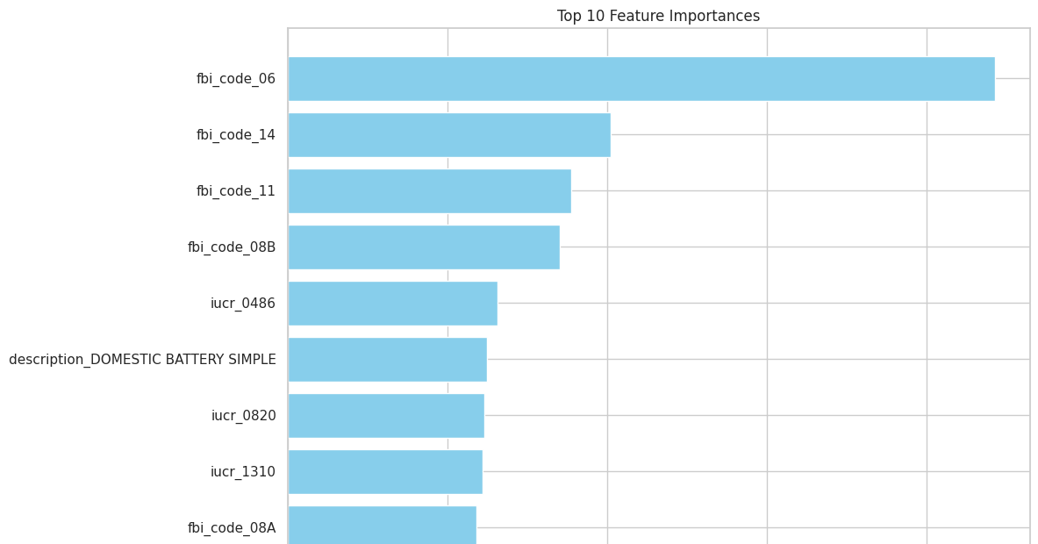
Hyperparameter Tuning and Validation Performance
Hyperparameter Tuning: GridSearchCV optimized parameters to achieve 99.5% validation accuracy.
Key Insights:
No overfitting detected (Train: 100%, Validation: 99%).
Top features: fbi_code_06, fbi_code_14, iucr_0486, etc
Only 5 misclassifications, e.g., STALKING misclassified as ASSAULT.

Slide 10
Experiments to Improve Model Performance
Experiment 1: Feature Selection
Used Random Forest feature importance to retain top features.
Achieved 99.4% validation accuracy with reduced dataset size.
Improved interpretability by focusing on influential features.
Experiment 2: Regularization
Implemented Logistic Regression with L1 (Lasso) and L2 (Ridge) regularization.
Both models achieved 100% validation accuracy.
Insights: L1 (Lasso) effectively selected key features by shrinking irrelevant coefficients, while L2 (Ridge) minimized overfitting by penalizing large coefficients.

Slide 11
Conclusion
Key Insights:
Crime patterns are highly influenced by community areas and certain features like FBI codes.
Feature selection and regularization significantly improved model performance and interpretability.
Outcomes:
Achieved 99% validation accuracy using optimized models.
Demonstrated effective use of data science to analyze and predict crime types.
Future Scope:
Explore real-time predictions for public safety initiatives.
Extend analysis to include temporal trends and seasonal patterns for better crime prevention.

Slide 12

Thank You

